Slide 1
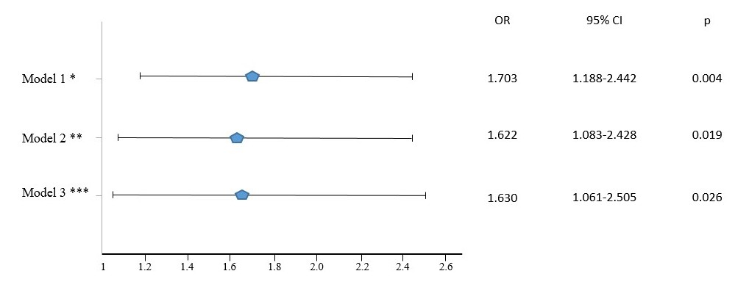
Associations between high triglycerides and arterial stiffness in a population-based sample: Results from the Kardiovize 2030 study
Iuliia Pavlovska^{1,2}, Juan P. González-Rivas^{1,3}, Juraj Jakubik¹, Jana Hruskova¹, Sarka Kunzova¹, Maria Skladana¹, Irma Magaly Rivas-Serna¹, Jose R. Medina-Inojosa⁴, Francisco Lopez-Jimenez⁴, Robert Vysoky², Yonas E. Geda,⁵ Gorazd B. Stokin¹.
¹International Clinical Research Center, St Anne’s University Hospital, Brno, Czech Republic, ²Department of Public Health, Faculty of Medicine, Masaryk University, Brno, Czech Republic, ³Harvard TH Chan School of Public Health. Harvard University, Boston, USA, ⁴Division of Preventive Cardiology, Department of Cardiovascular Medicine, Mayo Clinic, Rochester, MN, USA, ⁵ Mayo Clinic Study of Aging, Rochester, MN, USA.
components
INTRODUCTION
RESULTS
= 66.1%) and 86 cm in women (sensitivity= 76.2% and specificity = 61.4%) were optimal for
Cardiovascular disease (CVD) was the leading cause of mortality worldwide in 2017. A main factor in the development of the arteriosclerosis, that can lead to CVD, is arterial stiffness (ArSt), which describes the reduced capability of an artery to expand and contract in response to pressure changes and is recognized as an independent predictor of CVD. Measuring the cardio-ankle vascular index (CAVI) is a relatively novel way of ArSt quantification. The association between high triglycerides (TG) and ArSt shows contradictory results.¹⁻⁶ Many studies report no association between high TG and ArSt,^{1,3,5} and many others report positive independent association between them.^{2,4,6} Most of these studies are not evaluating randomly selected population-based samples,^{2,3} mostly including high-risk individuals,^{1,4} older age groups, ^{4,5} and adjusting for components that are not specifically designed to evaluate the association between both parameters.^{5,6} According to the best of our knowledge, none previous study was focused specifically on providing the answer to the question if high TG are associated with ArSt.
In total 1934 participants were included
Participants were 44.7% males with median (interquartile range) age of 48 (19) years. Men had higher BP, blood glucose, TG, waist circumference, and CAVI than women, but lower age, HDL-c and total cholesterol.
Median (Interquartile range) TG and CAVI were 1.0 (0.7) and 7.2 (1.4), respectively
The prevalence of high CAVI (≥9) was 10.0 %, higher in men than women, 14.5% and 6.4% (p < 0.001), respectively
Prevalence of high CAVI was associated with male gender, higher age, high BP, dysglycemia, abdominal obesity, and high total cholesterol, but not related to smoking and low HDL-c.
Correlation between TG and CAVI was 0.136 (p<0.001)
High TG (≥ 1.7 mmol/l) increased the odds of having high CAVI (≥9) by 63%, independent of multiple confounding variables as age, gender, components of metabolic syndrome, total cholesterol, and smoking habits.
Figure: Binary regression models associating high TG ≥ 1.7 mmol/l and high CAVI ≥ 9. * adjusted by age and gender. ** adjusted by age, gender, high waist circumference ≥80 cm in females and ≥94 cm in males, elevated fasting glucose ≥ 5,6 mmol/l or treatment, systolic and diastolic BP levels, HDL values. *** as model 2, further adjusted by smoking status (4 categories) and TC levels.
Abbreviations: BP – blood pressure, CAVI – cardio-ankle vascular index, CI – confidence interval, HDL – HDL cholesterol, OR – Odds ratio, TC – total cholesterol, TG – triglycerides.
STUDY AIM
Table: Prevalence of high CAVI and risk factors related using a Univariate Analysis
Variables | High CAVI values (%) | OR | 95% CI | p
n (%) | 10.03
Age 25-44/Age 45-64 | 1.1 /17.1 | 19.229 | 9.785-37.790 | < 0.001
Male/Female gender | 14.5 /6.4 | 2.454 | 1.802-3.342 | < 0.001
High/Normal BP | 19.1/3.3 | 7.009 | 4.819-10.194 | < 0.001
With/Without Dysglycemia | 23.1/7.7 | 3.589 | 2.586-4.980 | < 0.001
With/Without Abdominal Obesity | 12.9/6.3 | 2.202 | 1.584-3.062 | < 0.001
High/Normal Triglycerides | 18.2/8.0 | 2.561 | 1.867-3.514 | < 0.001
Low/Normal HDL | 10.2/10.0 | 1.026 | 0.664-1.587 | 0.911
With/Without Metabolic Syndrome | 20.9/6.7 | 3.662 | 2.7-4.967 | < 0.001
Smoker/Non Smoker | 7.7/10.7 | 0.696 | 0.475-1.020 | 0.073
High/Normal TC | 12.8/7.5 | 1.798 | 1.328-2.433 | < 0.001
CONCLUSION
To evaluate the association between high TG and ArSt, measured by CAVI, adjusting for MetS components and other traditional risk factors, in a random population-based sample of European adults.
TG levels were correlated with ArSt, measured as CAVI. High TG were associated with high CAVI independently of age, gender, and the presence of additional MetS components, smoking status and total cholesterol. This result highlights the negative influence of high TG in the process of atherosclerosis.
METHODS
Population-based, cross-sectional, randomized sample, which included over 2 000 citizens of Brno aged between 25 and 65
Personal history and demographic characteristics were evaluated using comprehensive questionnaires or face-to-face interview
CAVI was measured using VaSera VS-1500N device (Fukuda Denshi Co., Ltd., Japan)
Laboratory analyses were performed with 12-hour fasting blood samples (blood lipids and glucose)
Univariate analysis was used to assess the relationship between classic CV risk factors and high CAVI
3 models of logistic regression, adjusted by multiple confounders, were performed to determine the independent association between TG and CAVI.
CONFLICTS OF INTEREST
The authors declare no conflict of interest
REFERENCES
Laucevičius A, et al. Medicina (Mex) 2015; 51: 152–158
Wen J, et al. Hypertens Res Off J Jpn Soc Hypertens 2019; 42: 1223–1230
Wang H, et al. J Am Soc Hypertens JASH 2013; 7: 426–431
Zhao X, et al. Clin Exp Hypertens 2018; 40: 312–317
Topouchian J, et al. J Hypertens 2018; 36: 824
Nagayama D,, et al. J Atheroscler Thromb 2018; 25: 621–633

